Slide 1

Hate Speech Detection
Machine Learning Project

Slide 2
contents
01
Introduction
02
Statement of the Problem
03
Objectives
04
Methodology
05
Implementation

Slide 3
01
Hate Speech Detection
Introduction
The social media as well as other online platforms are playing an extensive role in the breeding and spread of hateful content eventually which leads to hate crime.
The automatic detection of hate speech is a challenging task due to disagreements on different hate speech definitions
Therefore, this project contributes to solving this problem by building ML classifiers model on standard hate speech datasets
Therefore the problem that we are trying to address is the current outspread of hate speech across different online communities and investing our time and skill into this project hoping it will create a much safer environment for those who engage in different online communities.

Slide 4
01
Hate Speech Detection
Objective
The main objective of this project is to develop an automated machine learning based approach for detecting hate speech and offensive language
Automated detection corresponds to automated learning such as machine learning: supervised and unsupervised learning. We use a supervised learning method to detect hate.
Classify text into two classes(like: hate and non-hate)

Slide 5
01
Hate Speech Detection
Methodology
In this project supervised machine learning is used by experimenting on two Classifiers, Logistic Regression and SVM. The labeled datasets were preprocessed for removal of noisy elements from its contents. Appropriate features are extracted to enable the machine to learn offensive term patterns. Finally the performances of different Classifiers and feature models are compared to choose the best performing model

Slide 6
01
Hate Speech Detection
Methodology
In this project supervised machine learning is used by experimenting on two Classifiers, Logistic Regression and SVM. The labeled datasets were preprocessed for removal of noisy elements from its contents. Appropriate features are extracted to enable the machine to learn offensive term patterns. Finally the performances of different Classifiers and feature models are compared to choose the best performing model

Slide 7
01
Hate Speech Detection
Dataset
The data-set were available in English languages following the link, https://drive.google.com/drive/folders/1uQiyJ_mDlOCcecMw7C-JYUs9bGnVJ_j8 .
The data-set consists of 24,582 data in total where 20,582 are categorized as hate speech and 4161 are categorized as non-hate
Language | Type of text | % | Total
English | Hate | 20582( 83.7% ) | 24582
 | Non-Hate | 4161( 16.9% )

Slide 8
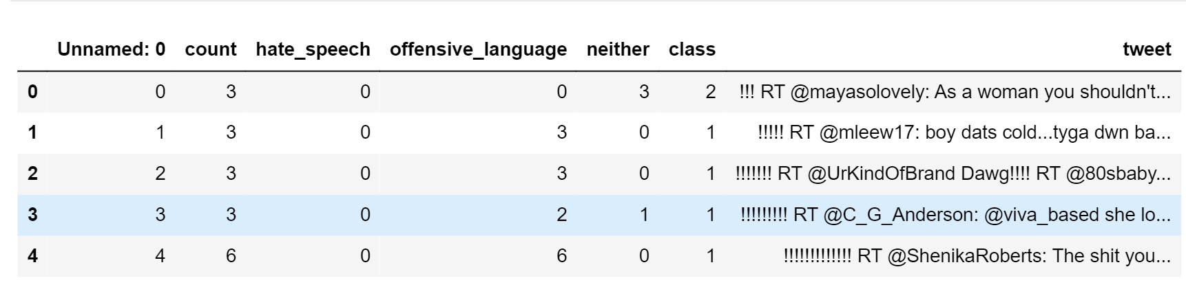
01
Hate Speech Detection
cont...

Slide 9
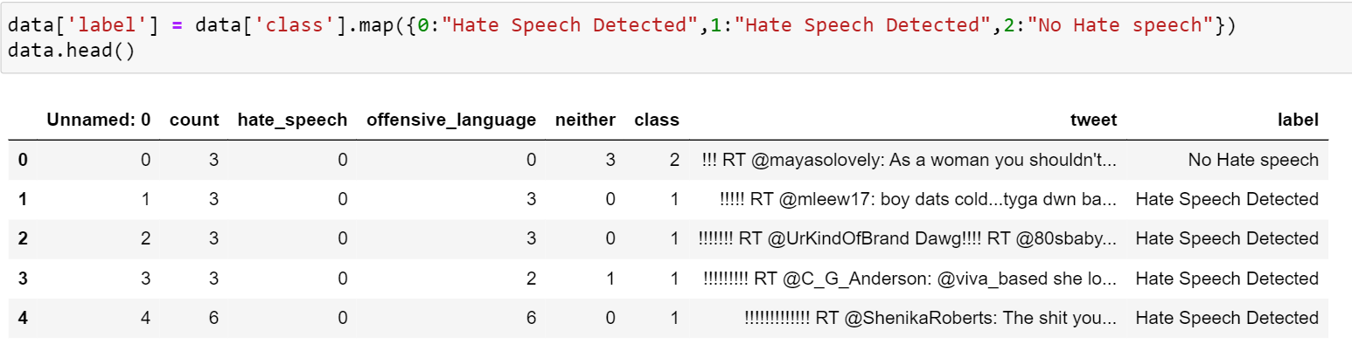
01
Hate Speech Detection
Data Processing
The first thing we did was mapping the offensive language and the hate speech as hate speech and the niether class as non- hate speech

Slide 10
01
Hate Speech Detection
cont....
Here we have defined the techniques used in preprocessing tweets:
➢Letter casing: Converting all letters to either upper case or lower case.
➢Tokenizing: Separating piece of text into tokens most often into individual words
➢Lemmatization:Eliminating affixes ( suffixes, prefixes, infixes) from word in order to obtain word stem
➢Vectorization:process of converting tokens to numbers since machine learning algorithm works with numbers and not text

Slide 11
01
Hate Speech Detection
cont....
below is the thought process involved with each of the specific steps we identified working with the dataset to prepare the data for the modeling process:
➢We removed the hash from the hashtags
➢We removed the HTML links since a lot of users link a website reference as part of the tweet.
➢We then removed any punctuation.
➢We then lowercased all the tweets for tokenizing.
➢Additional steps before modeling includes tokenization, lemmatizing, stemming, and vectorizing.

Slide 12
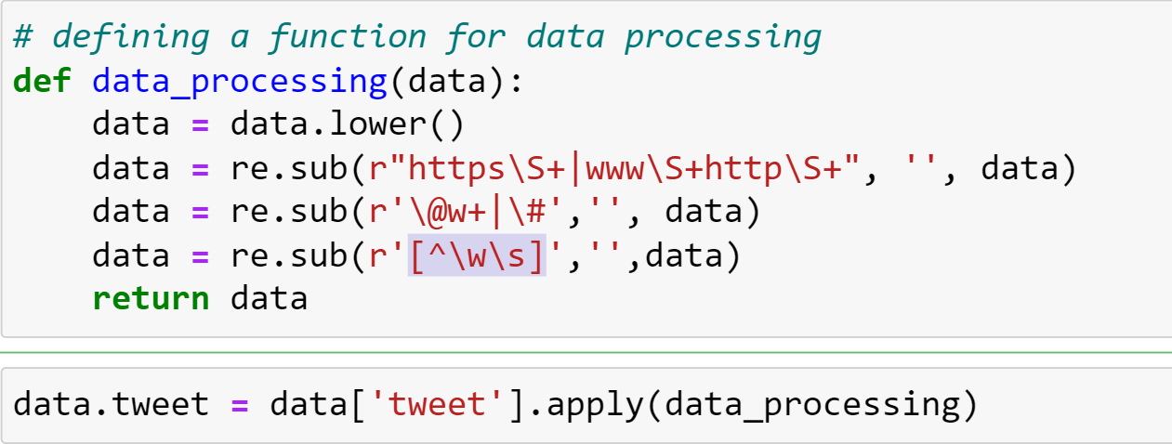
01
Hate Speech Detection
cont....

Slide 13
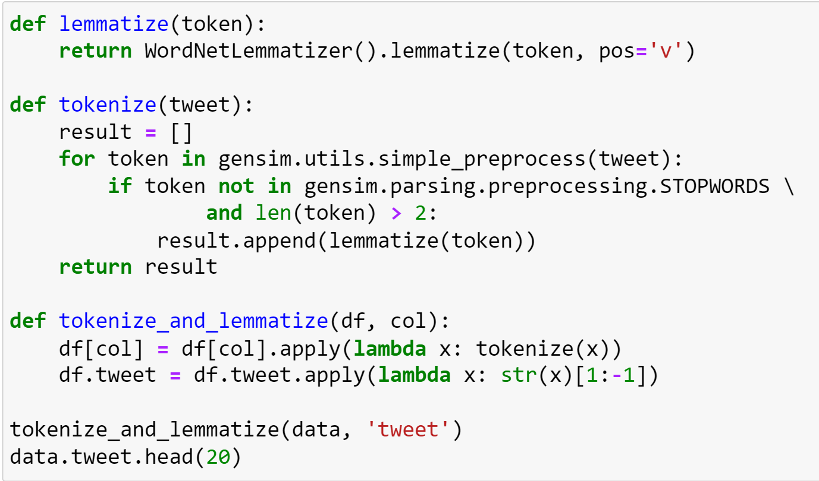
01
Hate Speech Detection
cont....

Slide 14
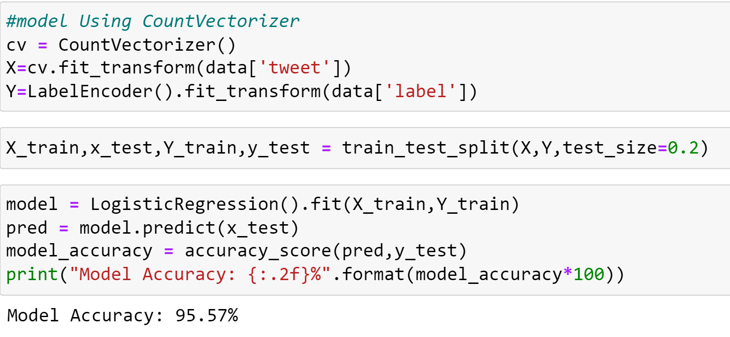
01
Hate Speech Detection
cont....
TfidfVectorizer and CountVectorizer both are methods for converting text data into vectors as model can process only numerical data.
In CountVectorizer we only count the number of times a word appears in the document which results in biasing in favour of most frequent words. this ends up in ignoring rare words which could have helped is in processing our data more efficiently.
In TfidfVectorizer we consider overall document weightage of a word. It helps us in dealing with most frequent words. Using it we can penalize them. TfidfVectorizer weights the word counts by a measure of how often they appear in the documents

Slide 15
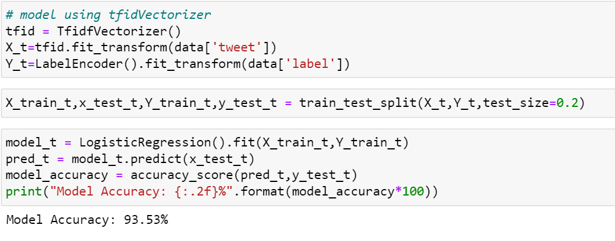
01
Hate Speech Detection
cont....

Slide 16
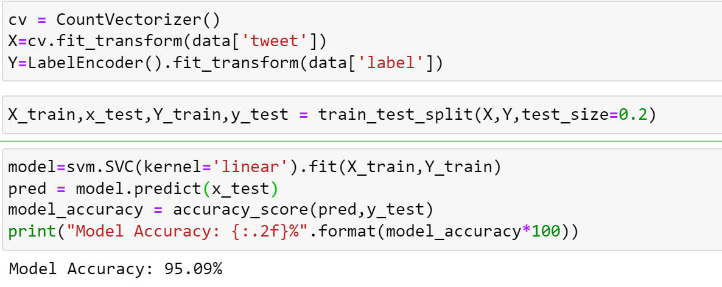
01
Hate Speech Detection
cont....

Slide 17
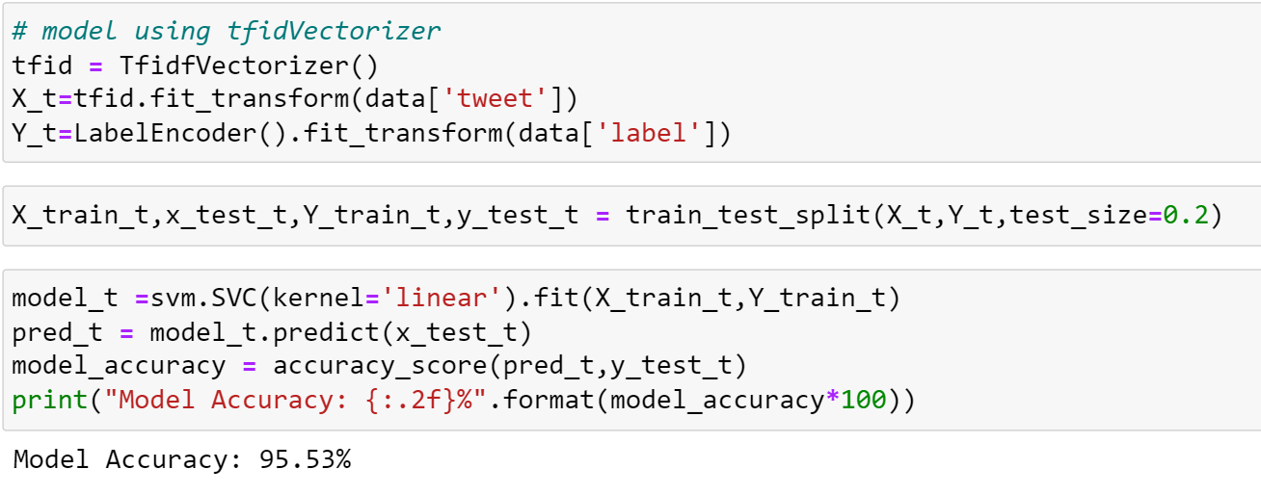
01
Hate Speech Detection
cont....

Slide 18
01
Hate Speech Detection
cont....
Accuracy Comparision
 | CountVectorizer | TfidfVectorizer
Logistic Regression Model Accuracy | 95.57% | 93.53%
SVM Model Accuracy | 95.09% | 95.53%
From the Accuracy we have deduced that its better to use the logistic Regression model using the CountVectorizer. In order to integrate the model to our interface, which is a website developed using the python framework Flask, we need to save it as a Pickle file is used for Serialization refers to the process of converting an object in memory to a byte stream that can be stored on disk or sent over a network.

Slide 19
01
Hate Speech Detection
Implementation
Saving the Model.

Slide 20
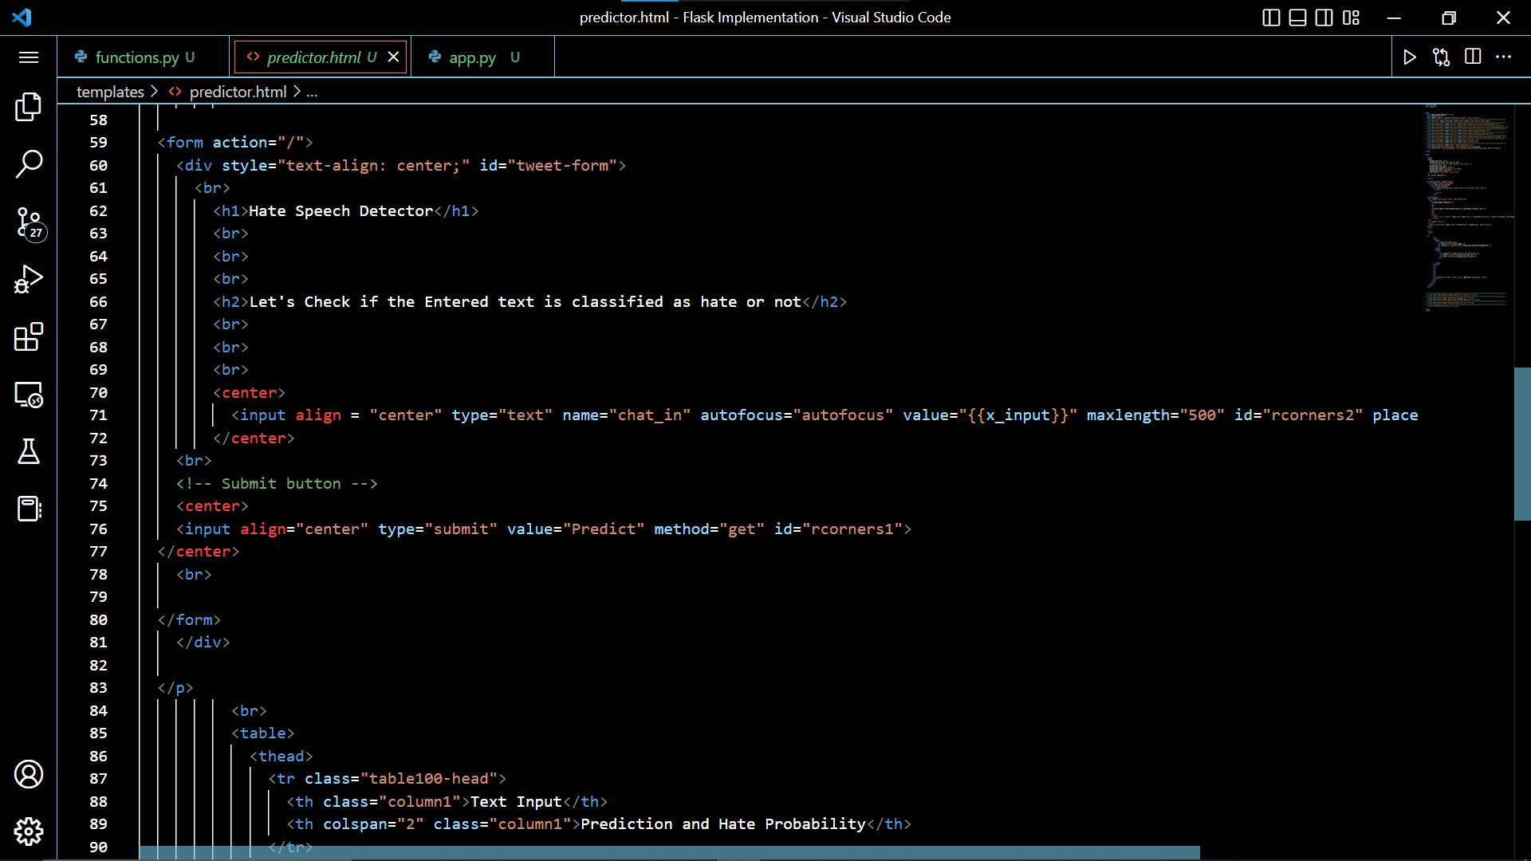
01
Hate Speech Detection
cont....
Saving the Model.

Slide 21
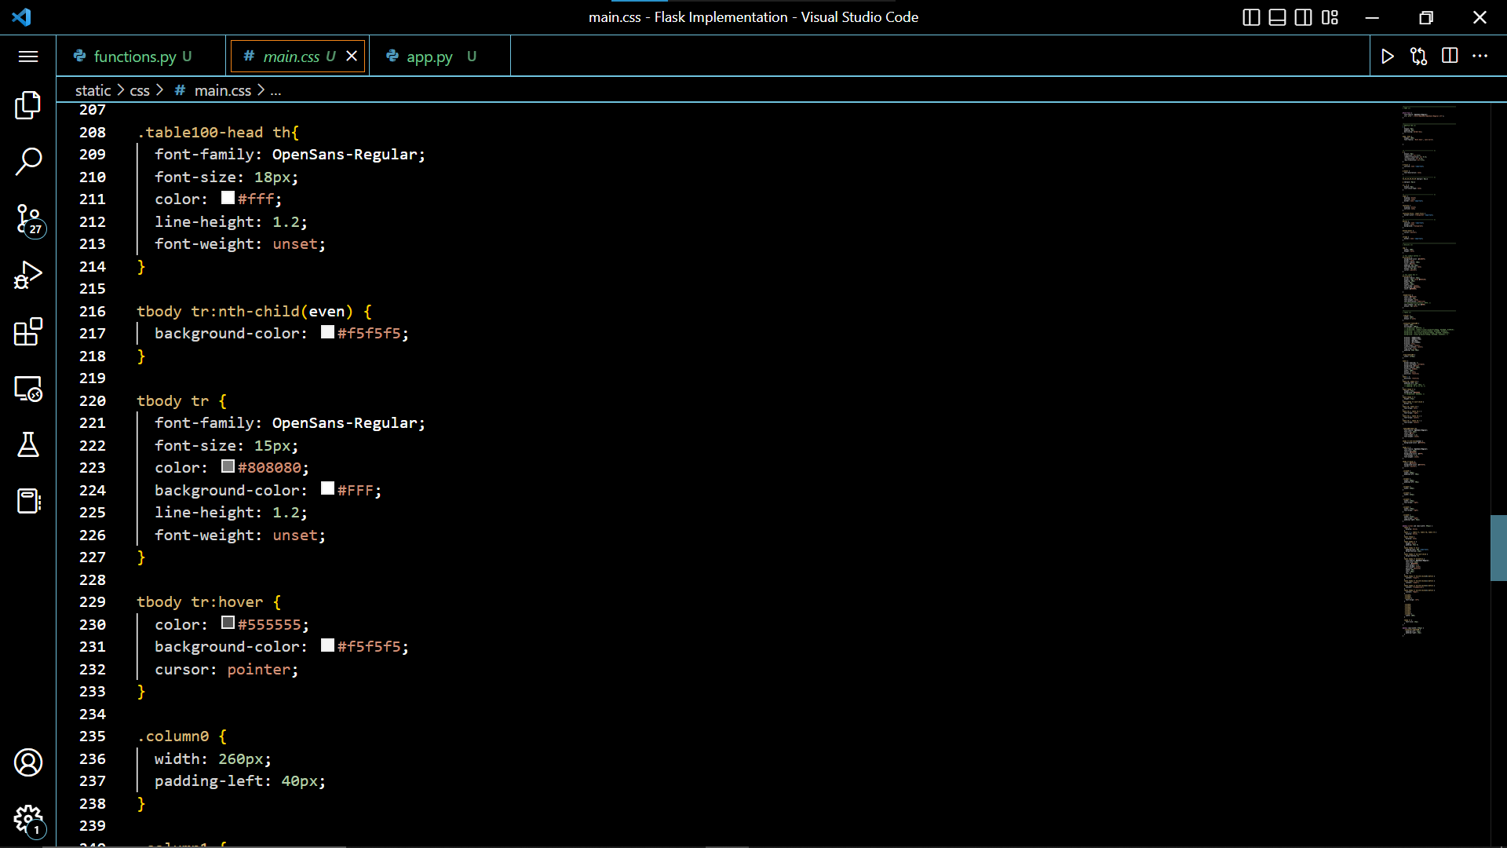
01
Hate Speech Detection
cont....
Saving the Model.

Slide 22
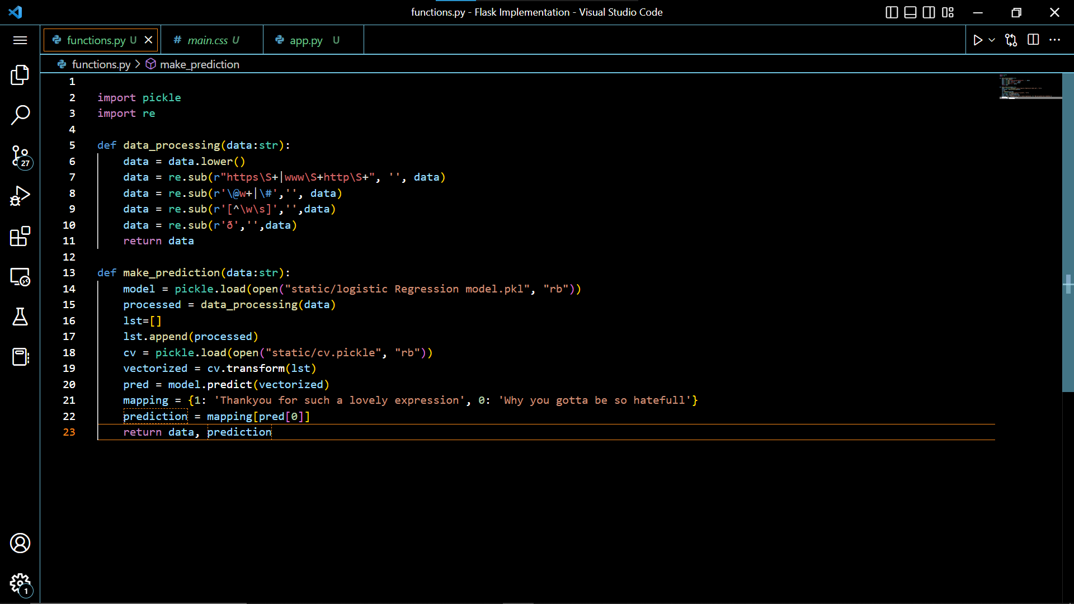
01
Hate Speech Detection
cont....
Saving the Model.

Slide 23
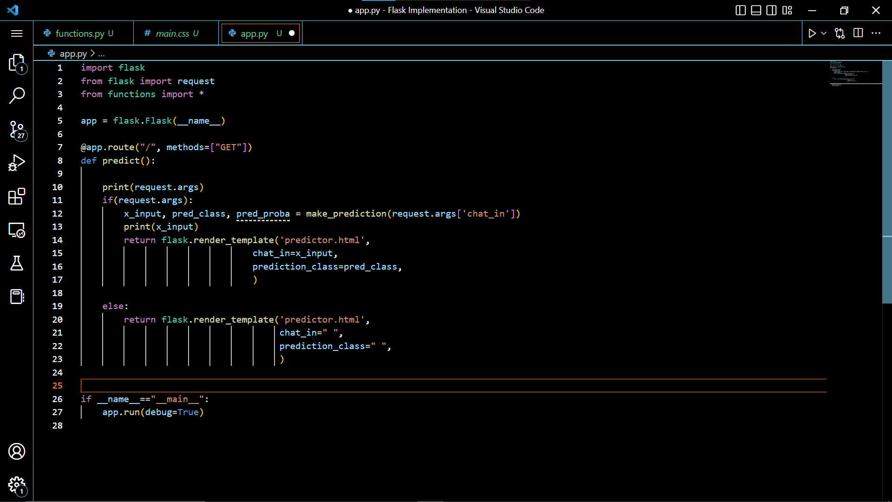
01
Hate Speech Detection
cont....
Saving the Model.

Slide 24
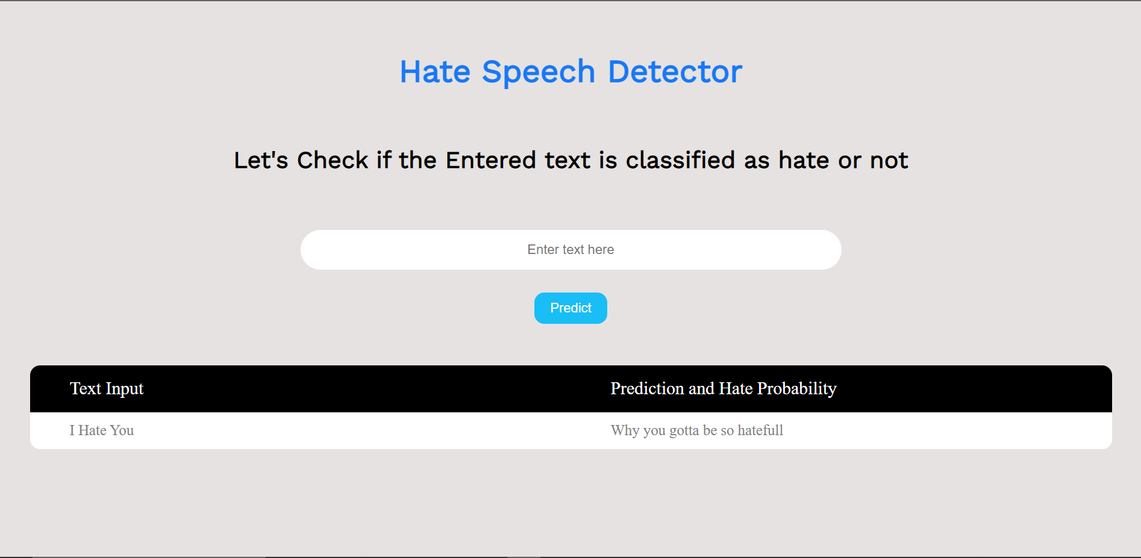
01
Hate Speech Detection
cont....
Saving the Model.

Slide 25
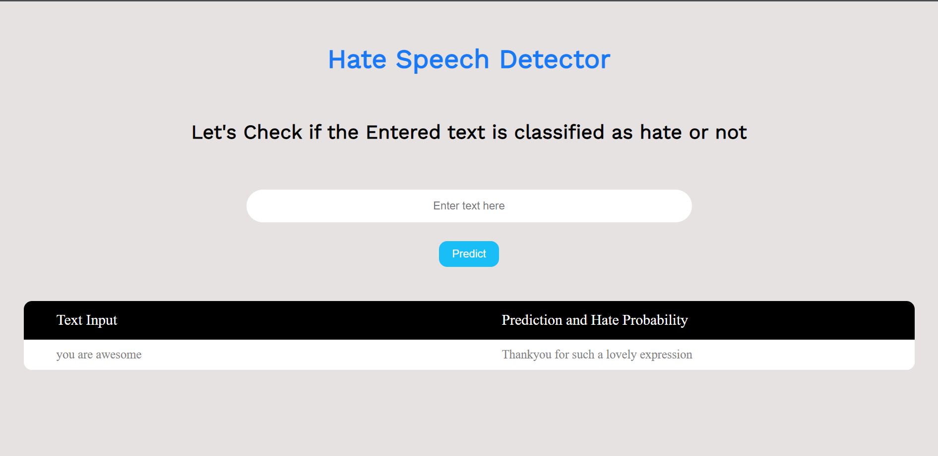
01
Hate Speech Detection
cont....
Saving the Model.

Slide 26
THANK YOU!
THANK YOU FOR WATCHING

